Slide 1



Wikidata for academics
Large-scale, interdisciplinary, multilingual, open data
Thomas Shafee, CC BY 4.0

Slide 2




Outline
Why should you be interested in Wikidata?
A brief introduction to the largest open knowledgebase
Why you might draw data from it
Why you might deposit data into it
How to put data in
How read data from
Different ways to editing and create items
One at a time (direct manual editing)
Multiple at once (tool assisted batch editing)
Query information back out of Wikidata
SPARQL tool (and language)
A wide range of custom examples
Help, community and resources
The hidden world behind Wikidata

Slide 3

Wikipedia
z
Open access encyclopedia
300 language editions
Most-read source for most topics
Many pages read >100,000 times per year
Consulted by >95% of students
Consulted by >60% of clinicians
Consulted by >95% of researchers
Fox S, Jones S. Pew Internet. 2009 | Hughes B, Joshi I, Lemonde H, Wareham J. Int J Med Inform 2009 Oct;78(10):645-655 | Allahwala UK, Nadkarni A, Sebaratnam DF. Med Teach 2013 Apr;35(4):337 | Nutzung von Social-Media-Diensten in der Wissenschaft 2017 Goportis – Leibniz-Bibliotheksverbund

Slide 4
Wikidata
z
Structured data knowledgebase
Machine-readable
Multilingual
Inter-disciplinary
e.g. Research output metadata
e.g. Scholar & researcher data
e.g. Conceptual relationships
Notes:
For those who care: Standardised Resource Data Framework, part of semantic web

Slide 5
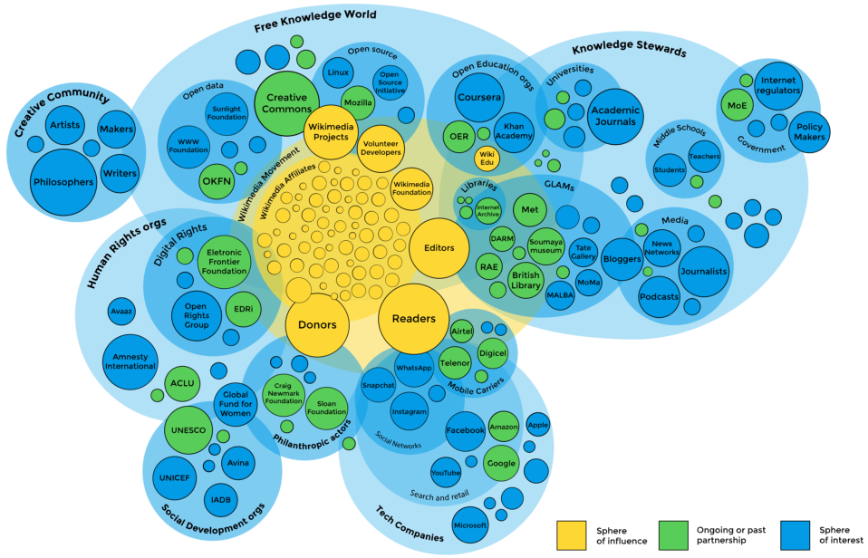
z
Part of wider open knowledge ecosystem
Maria Cruz, Ed Bland, Nicole Erber, Jaime Anstee, Guillame Paumier, Suzi Nuzzel – CC BY-SA

Slide 6

Why interact with Wikidata
Why deposit data into
Why draw info from
Machine-readable Wikipedia
make sure AIs understand the world
Ensure structured knowledge is FAIR
vs proprietary databases and walled gardens
There for the long term
not susceptible to funding cycles
Large existing community, tools, support
Do interdisciplinary research
Unique resource identifiers
Common data language
Inter-database dictionary
Make your projects multilingual
Transparent history for all items
Notes:
Describe data with flexible level of detail or abstraction
Centralize data and avoid duplication of effort
Avoid multiple copies falling out of sync
Connect disparate IDs and align datasets
Serve as discovery platform for data elsewhere
Lateral querying across arbitrary vectors

Slide 7
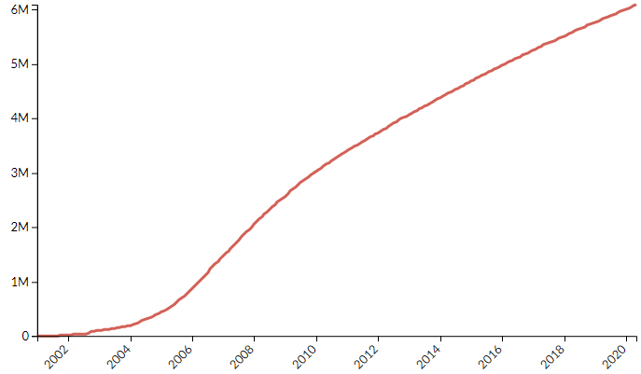
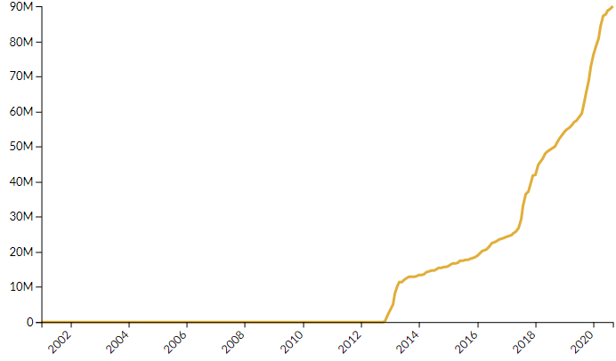
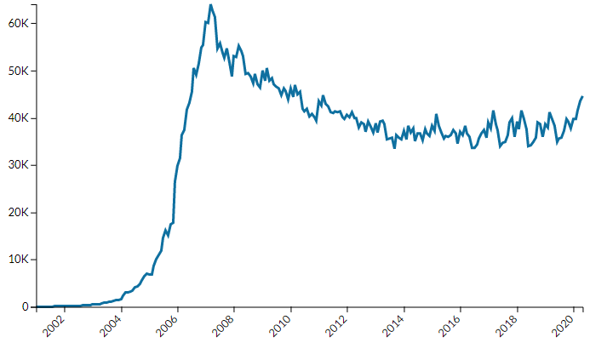
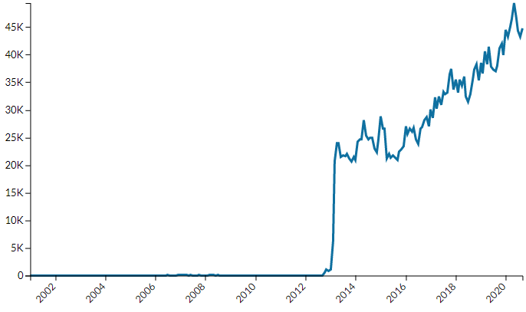
Wikipedia (en)
100M
Wikidata
6M
Number of articles
Number of items
50K
60K
Number of editors
Number of editors
https://stats.wikimedia.org
Notes:
General history in 4 graphs

Slide 8
Example items and properties
Concepts
E.g. locations, events, diseases, genes, languages, processes
Research outputs
E.g. publications, journals, publishers, clinical trials
People & orgs
E.g. Researchers, authors, universities, institutes
…
…
…
etc
COVID-19
(Q84263196)
Main subject (P921)
We Need Compassionate Leadership Management Based on Evidence to Defeat COVID-19
(Q96947691)
Author (P50)
Agnes Binagwaho
(Q4693015)
Has effect
(P1542)
cytokine release syndrome
(Q3961647)
Main subject (P921)
Colchicine
(Q326224)
Colchicine Coronavirus SARS-CoV2 Trial
(Q89154576)
Montreal Heart Institute
(Q3151984)
Research intervention (P4844)
Sponsor (P859)

Slide 9
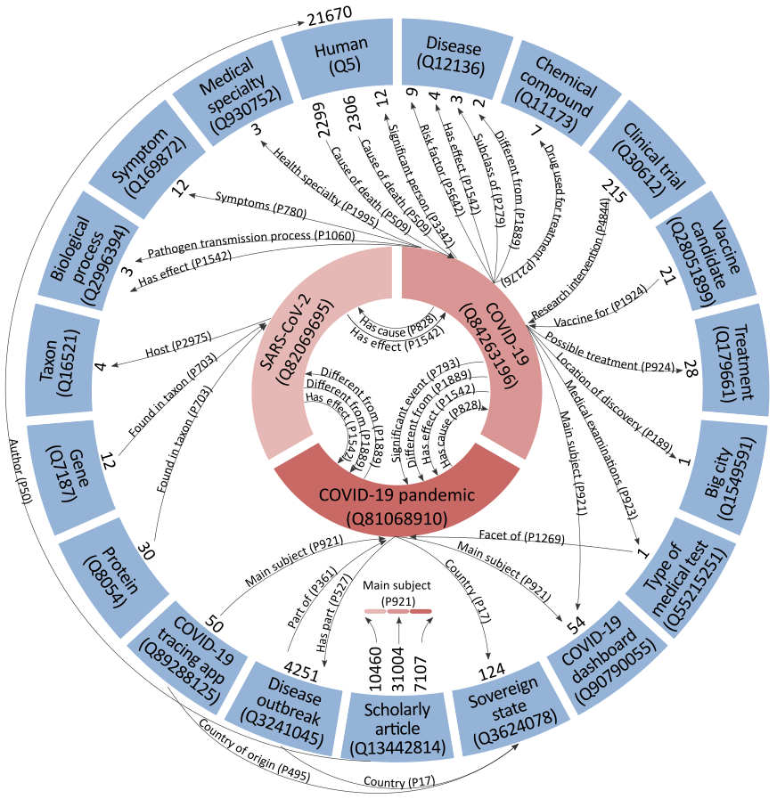
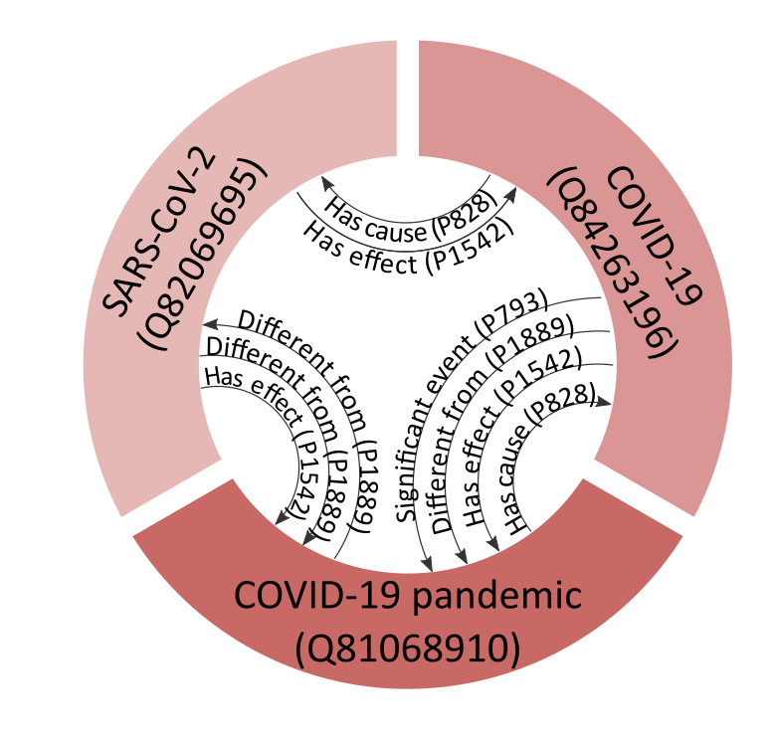
Thomas Shafee CC BY 4.0
Example items
and properties
Granular disambiguation of concepts
All of Wikidata tied into a single network
90M items
>1.1B connections
Links data from wide variety of disciplines
See also: https://doi.org/10.5281/zenodo.4033382

Slide 10
Outline
Why should you be interested in Wikidata?
A brief introduction to the largest open knowledgebase
Why you might draw data from it
Why you might deposit data into it
How to put data in
How read data from
Different ways to editing and create items
One at a time (direct manual editing)
Multiple at once (tool assisted batch editing)
Query information back out of Wikidata
SPARQL tool (and language)
A wide range of custom examples
Help, community and resources
The hidden world behind Wikidata

Slide 11
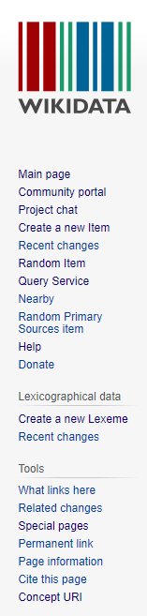
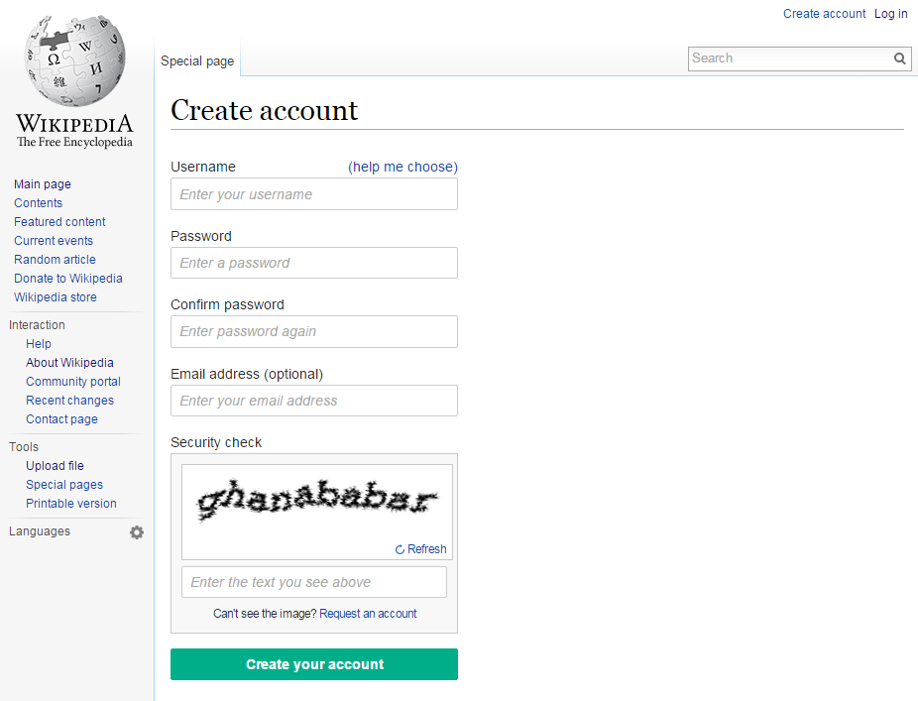
Signing up
Pseudonym
Orthonym
Not made public
Allows contact you via form

Slide 12
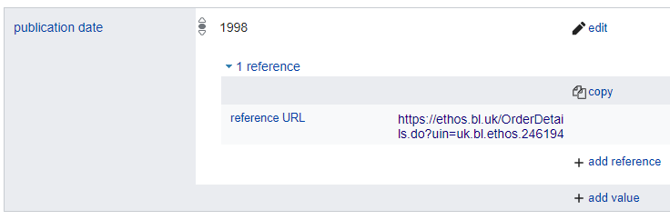

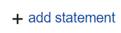
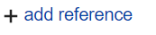
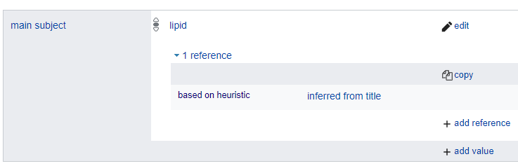
Lets manually edit an item
PhD theses that don’t list a publication date
Go to https://w.wiki/ekc and press
Find the thesis’s URL for the thesis
At the bottom of the Wikidata page,
Add “publication date” based on what’s listed at that URL
In that statement,
As the “reference URL”, use the thesis’s URL
PhD theses that don’t list a main topic
Go to https://w.wiki/ekg and press
Find the thesis’s URL for the thesis
At the bottom of the Wikidata page,
Add the main subject(s) based on the keywords or title
In that statement,
As the “reference URL”, add the thesis’s URL
(or) As the reference, add “based on heuristic” “inferred from title”

Slide 13
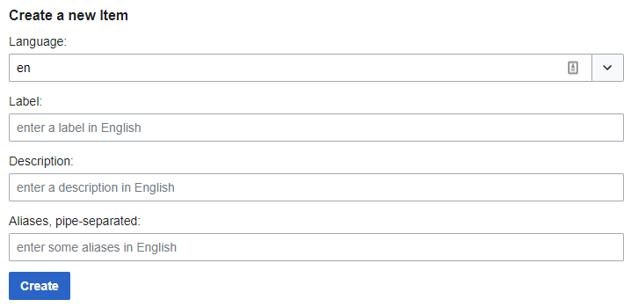
How to create an item
Add its first property!
“instance of” if it’s an example (e.g. the Titanic was an instance of a steamship)
“subclass of” if it’s a whole category (e.g. steamships are a subclass of ships)
Check similar items as to what other properties you could add

Slide 14
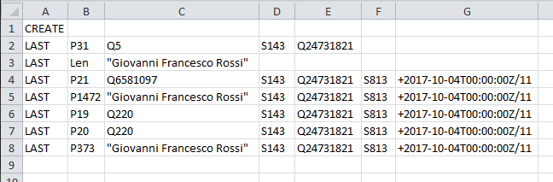
Lets bulk edit several items at once!
Two main tools: QuickStatements (https://quickstatements.toolforge.org)
OpenRefine (http://openrefine.org)
Import tabular data into Wikidata
Example:
Create a new item
It’s an instance of a human
Its label in English is…
Its sex/gender is male
Its place of birth is Rome
Its place of death is Rome
Item to edit
Statements to add
Supporting reference

Slide 15
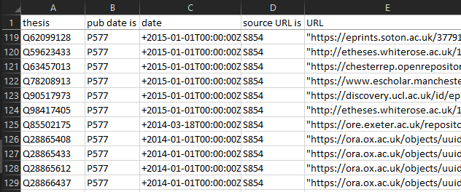
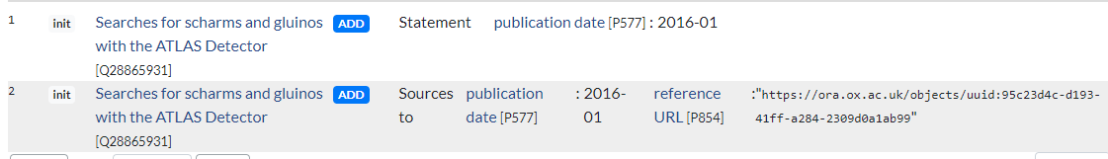
Lets bulk edit several items at once!
PhD theses that don’t list a publication date
Go to Docs for the list https://tinyurl.com/QSexample
To see where this list came from, see https://w.wiki/f25
Go to https://quickstatements.toolforge.org
Paste across a few random rows from the table
“Import V1 commands” (if tab separated)
(or) “Import CSV commands” (if comma separated)
Hit “Run” to add the information to Wikidata
quickstatements.toolforge.org

Slide 16
Outline
Why should you be interested in Wikidata?
A brief introduction to the largest open knowledgebase
Why you might draw data from it
Why you might deposit data into it
How to put data in
How read data from
Different ways to editing and create items
One at a time (direct manual editing)
Multiple at once (tool assisted batch editing)
Query information back out of Wikidata
SPARQL tool (and language)
A wide range of custom examples
Help, community and resources
The hidden world behind Wikidata

Slide 17
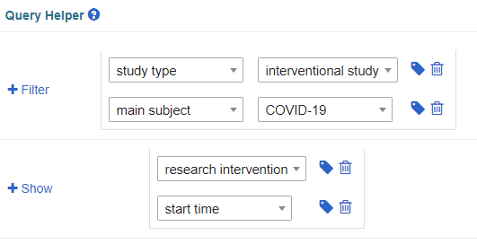
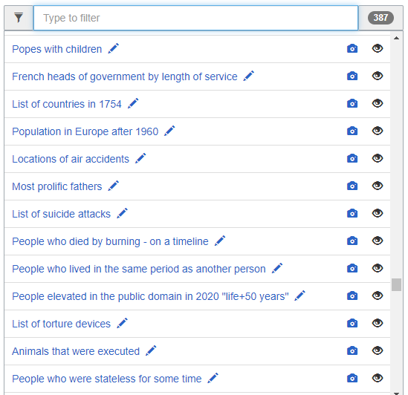


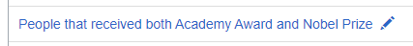
Lets query Wikidata’s contents
Find timeline of intervention studies on COVID-19
Go to query.wikidata.org
Filter for items that are interventional studies study type
Filter for items that are about COVID-19 as their main subject
Show their research intervention
Show their start time
Press
Go to the examples and find something interesting
Based on SQL language
Isn’t as scary as you think
The code is human-readable(ish)

Slide 18
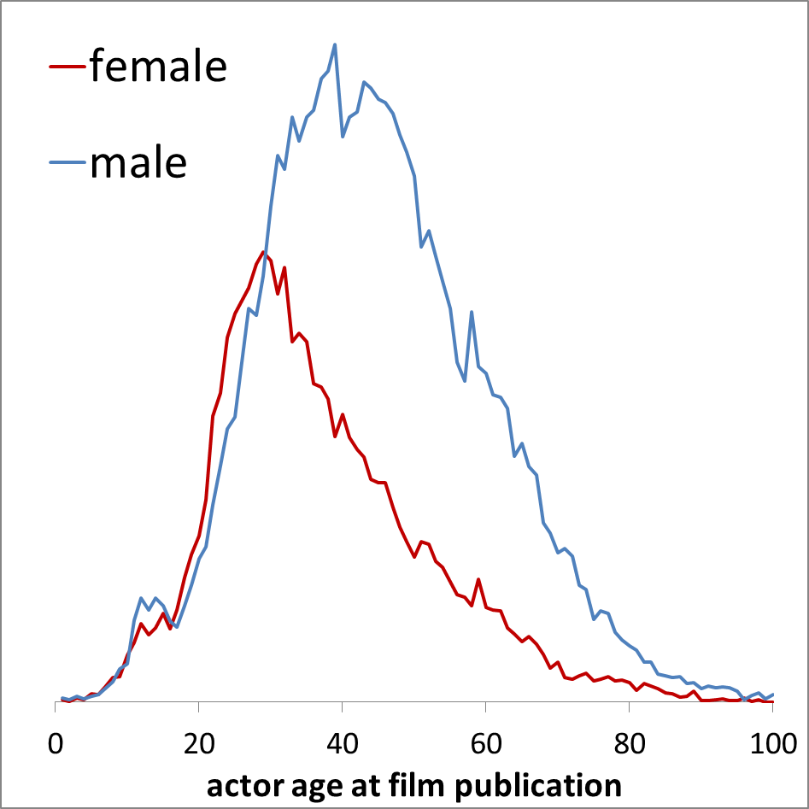
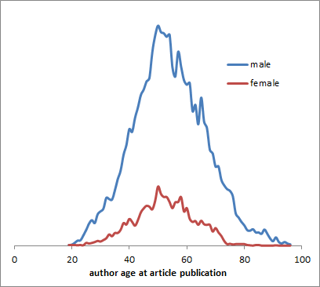
Example query results
Date
Gender
Gendered age bias: actors
vs academics
Date of birth
Sex or gender
Sex or gender
Actors
Academics
Actor
Academic
Cast member
Author
Movie
Publication
Publication date
Publication date
Date
Adapted from Toby Hudson, Uni. Sydney, CC- BY 4.0 ; https://w.wiki/Dw8 ; https://w.wiki/Dw9

Slide 19
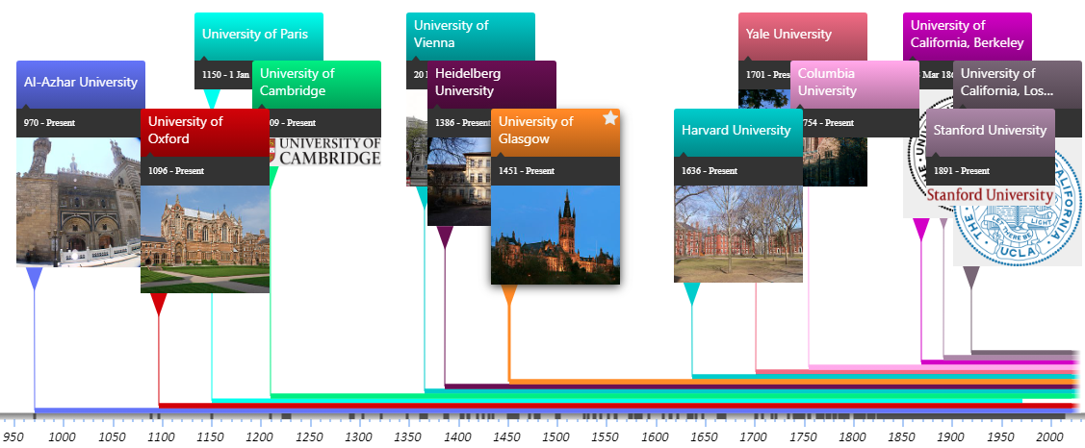
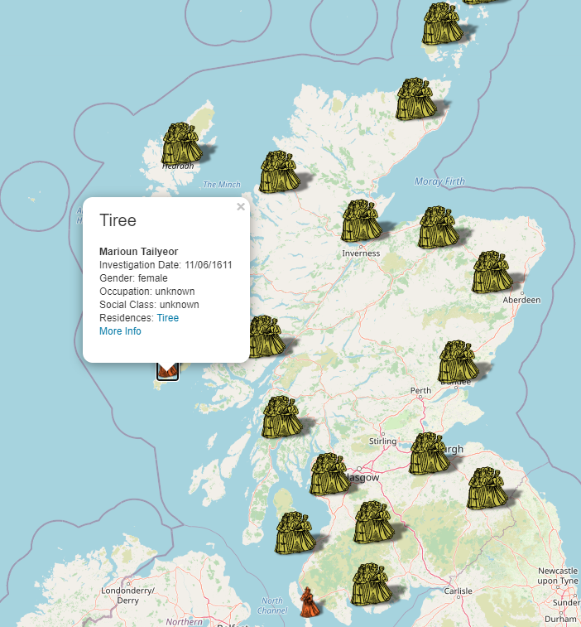
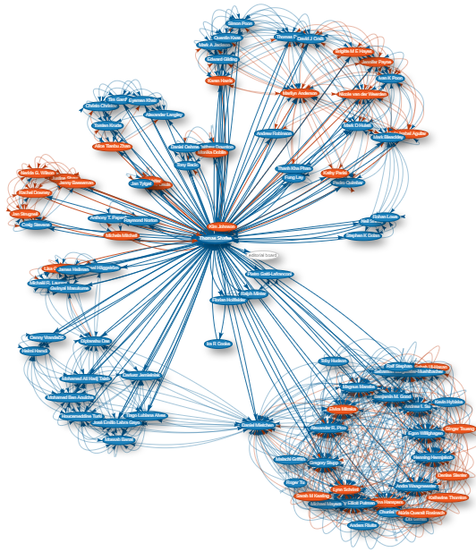
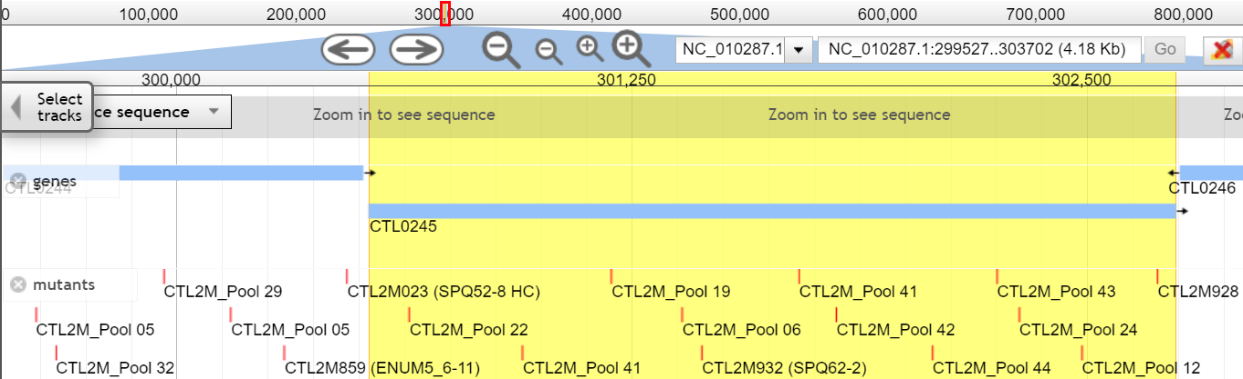
Some interesting usage examples for inspiration
Events timelines
histropedia.com/timeline
Map of witches in Scotland
witches.is.ed.ac.uk
Scholia dashboard
scholia.toolforge.org
Chlamydia genome browser
chlambase.org
https://www.wikidata.org/wiki/Wikidata:Tools/Visualize_data

Slide 20


So many tools!
General tools wikidata.org/wiki/Wikidata:Tools
Mix-n-match (tools.wmflabs.org/mix-n-match)
WD games (wikidata-game.toolforge.org/distributed)
Author disambiguator (author-disambiguator.toolforge.org)
Zotero importer (wikidata.org/wiki/Wikidata:Zotero)
Programmer tools wikidata.org/wiki/Wikidata:Tools/For_programmers
API for WikiData (wikidata.org/w/api.php)
for QuickStatements (quickstatements.toolforge.org/api.php)
Python package (github.com/dahlia/wikidata)
R package (github.com/TS404/WikidataR)

Slide 21
Outline
Why should you be interested in Wikidata?
A brief introduction to the largest open knowledgebase
Why you might draw data from it
Why you might deposit data into it
How to put data in
How read data from
Different ways to editing and create items
One at a time (direct manual editing)
Multiple at once (tool assisted batch editing)
Query information back out of Wikidata
SPARQL tool (and language)
A wide range of custom examples
Help, community and resources
The hidden world behind Wikidata

Slide 22
Where to get help?
General information
One-to-one
Interactive tours
wikidata.org/wiki/Wikidata:Tours
Academic introductory publications
Turki, Houcemeddine, et al. "Wikidata: A large-scale collaborative ontological medical database." Journal of biomedical informatics 99 (2019): 103292. doi: 10.1016/j.jbi.2019.103292
Allison-Cassin, et al. "Wikidata: a platform for your library’s linked open data." Code4Lib Journal 40 (2018). journal.code4lib.org/articles/13424
Library carpentry course
librarycarpentry.org/lc-wikidata
General help and discussion
wikidata.org/wiki/Wikidata:Project_chat
Request a custom SPARQL query
wikidata.org/wiki/Wikidata:Request_a_query
Special interest Wikiprojects
Examples: Chemistry Philosophy
Source Metadata Covid19
Open Access Ontology
wikidata.org/wiki/Wikidata:WikiProjects

Slide 23

Contact
Email Thomas.Shafee@gmail.com
Google Scholar Thomas Shafee
ResearchGate Thomas Shafee
LinkedIn Thomas Shafee
Username Search [[user:tshafee]]
Journals
WikiJournal of Medicine (WikiJMed.org)
WikiJournal of Science (WikiJSci.org)
WikiJournal of Humanities (WikiJHum.org)
PLOS (TopicPagesWiki.plos.org)
This presentation
https://w.wiki/i3E
Shafee, T; Mietchen, D; Su, A. (2017). “Academics can help shape Wikipedia” Science 357 (6351):557. doi:10.1126/science.aao0462
Turki, Houcemeddine, et al. "Wikidata: A large-scale collaborative ontological medical database" Journal of biomedical informatics 99 (2019):103292. doi:10.1016/j.jbi.2019.103292
Allison-Cassin, et al. "Wikidata: a platform for your library’s linked open data" Code4Lib Journal 40 (2018). journal.code4lib.org/articles/13424

Slide 24



Wikipedia info literacy
Abstinence-only education is ineffective
Read Wikipedia in last year for study or work:
Check warning notices (header, sections & talkpage)
Check the references
Check the internal quality rating (talkpage)
Therefore need to teach safe scholarship
Pseudo
peer-reviewed
Fox S, Jones S. Pew Internet. 2009 | Hughes B, Joshi I, Lemonde H, Wareham J. Int J Med Inform 2009 Oct;78(10):645-655 | Allahwala UK, Nadkarni A, Sebaratnam DF. Med Teach 2013 Apr;35(4):337 | Nutzung von Social-Media-Diensten in der Wissenschaft 2017 Goportis – Leibniz-Bibliotheksverbund
Notes:
Also 87% of teachers
Also 35% of pharmacists
Policymakers and Journalists
Lawmakers have cited Wikipedia in >400 judicial decisions

Slide 25
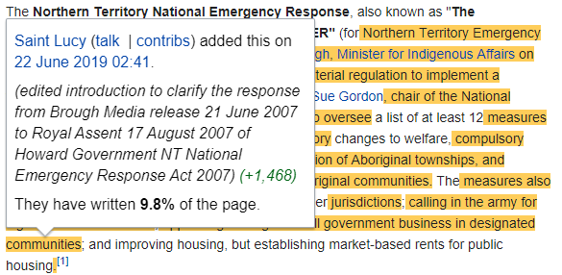
Wikipedia info literacy
Abstinence-only education is ineffective
Read Wikipedia in last year for study or work:
Check warning notices (header, sections & talkpage)
Check the references
Check the internal quality rating (talkpage)
Therefore need to teach safe scholarship
Advanced:
Only cite WP directly if describing/studying what is stated therein
“Wikipedia presents a lay definition of X as… (page, date, version link)”
History and whocolor tool show when and who added content
Fox S, Jones S. Pew Internet. 2009 | Hughes B, Joshi I, Lemonde H, Wareham J. Int J Med Inform 2009 Oct;78(10):645-655 | Allahwala UK, Nadkarni A, Sebaratnam DF. Med Teach 2013 Apr;35(4):337 | Nutzung von Social-Media-Diensten in der Wissenschaft 2017 Goportis – Leibniz-Bibliotheksverbund
Notes:
Also 87% of teachers
Also 35% of pharmacists
Policymakers and Journalists
Lawmakers have cited Wikipedia in >400 judicial decisions

Slide 26

Wikipedia student writing
Examples
Currently primarily US, Canada (some Europe)
Pharmacology | Boston University
Chemistry | Massachusetts Institute of Technology
Interdisciplinary social science | Rice University
Literature | Georgetown University
Students work in group to write/update a Wikipedia page
Supervision by course organiser
Support by WikiEdu foundation
Free online LMS system
dashboard.wikiedu.org
Free training materials
Best practice documentation
Efficacy
Increased student information literacy
High satisfaction outcomes
Cheap to run
High exposure of student work
Azzam, Amin, et al. "Why medical schools should embrace Wikipedia: final-year medical student contributions to Wikipedia articles for academic credit at one school." Academic medicine 92.2 (2017): 194. doi.org/10.1097/ACM.0000000000001381

Slide 27
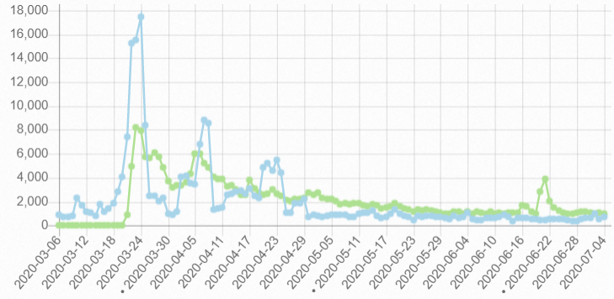
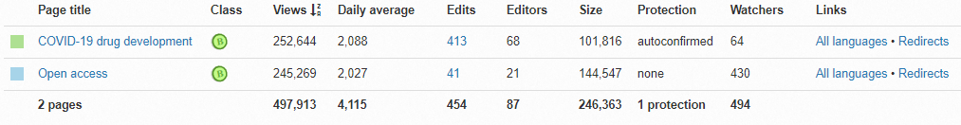
Wikipedia Impact assessment
Detailed pageview stats available
All readers read the lede section
Subsequent sections are each read by ~20%
Basic AltMetrics on research outputs
Pageviews analysis
Where: Which page(s) and which section(s) cites it?
What: Is it supporting important or trivial point? Is it cited multiple times?
When: How long has the citation been there?
https://pageviews.toolforge.org/

Slide 28

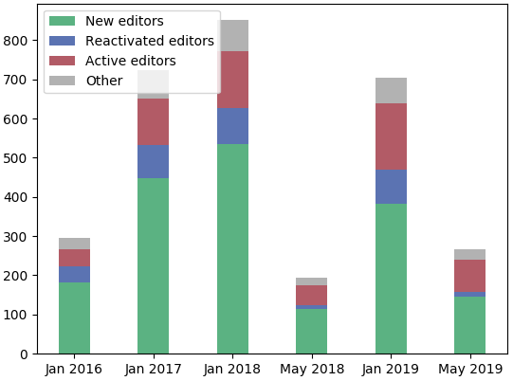
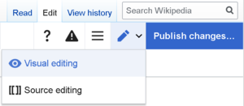
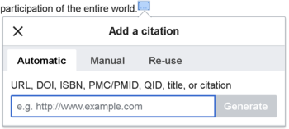
Wikipedia direct contribution
Detailed pageview stats available
Organised by the Wikipedia Library
#1lib1ref campaign
Citation hunt tool
tools.wmflabs.org/citationhunt
Number of librarians
Powered by Zotero
meta.wikimedia.org/wiki/The_Wikipedia_Library/1Lib1Ref

Slide 29
Combining reach and rigour
compatible interfaces between two worlds

Slide 30
Who reads Wikipedia?
Thesis
1-10
Median Wikipedia page
10,000 pa
Median Journal Paper
800
Readership includes: Researchers
Students
Patients
Journalists
Clinicians
Lawmakers
Top 5% Journal Paper
3,000
Top 5% Wikipedia page
1,000,000 pa
Shafee T (2017) Wikipedia-integrated publishing: a comparison of successful models. Health Inform. 26(2)
Notes:
Re-emphisise that patients are making health decisions based on what they read online

Slide 31
Who reads Wikipedia?
Covid-19
400,000 per day
Thesis
1-10
Median Wikipedia page
10,000 pa
Median Journal Paper
800
Readership includes: Researchers
Students
Patients
Journalists
Clinicians
Lawmakers
Top 5% Journal Paper
3,000
Top 5% Wikipedia page
1,000,000 pa

Slide 32
Quality control
Creation
Articles for Creation (Drafts not yet added to encyclopedia)
New page patrol (Articles recently added)
>2000 new articles submitted per day (70-80% are deleted)
Modification
Articles for Deletion
Speedy deletion (1 day)
Proposed deletion (1-4 weeks)
50 per day
Deletion
Notes:
Overall Birth-and-Death model for articles, but most work done in modification
>300 active editors in each stage
600 new articles per day
500 deletions per day

Slide 33
Quality control
Bots
(<1 minute)
Human
(<1 hour)
Human
(hours - days)
Quality rating
Machine-learning:
Watching new edits stream
Apprx. 100 at any time
e.g. sentences lacking references
Checking for more subtle errors
Bayesian neural network
Turnitin: Copyright violation
Creation
Modification
Deletion
Notes:
Overall Birth-and-Death model for articles, but most work done in modification

Slide 34


Quality control
Creation
Editorial review
5-10 reviewers
1 reviewer
Internal assessment
Modification
Wikipedia’s Plant Biology pages
Quality comparable to Encyclopædia Britannica back in 2005
Accuracy varies by topic, but broad trends:
Inconsistent coverage
Missing / out of date information
Missing illustration
Difficult readability
Deletion
External assessment
Nature 2005 438:900 | S Fox, M Duggan Pew internet 2013 | T Shafee et al. (2017) JECH. 71(10)
Notes:
Overall Birth-and-Death model for articles, but most work done in modification

Slide 35
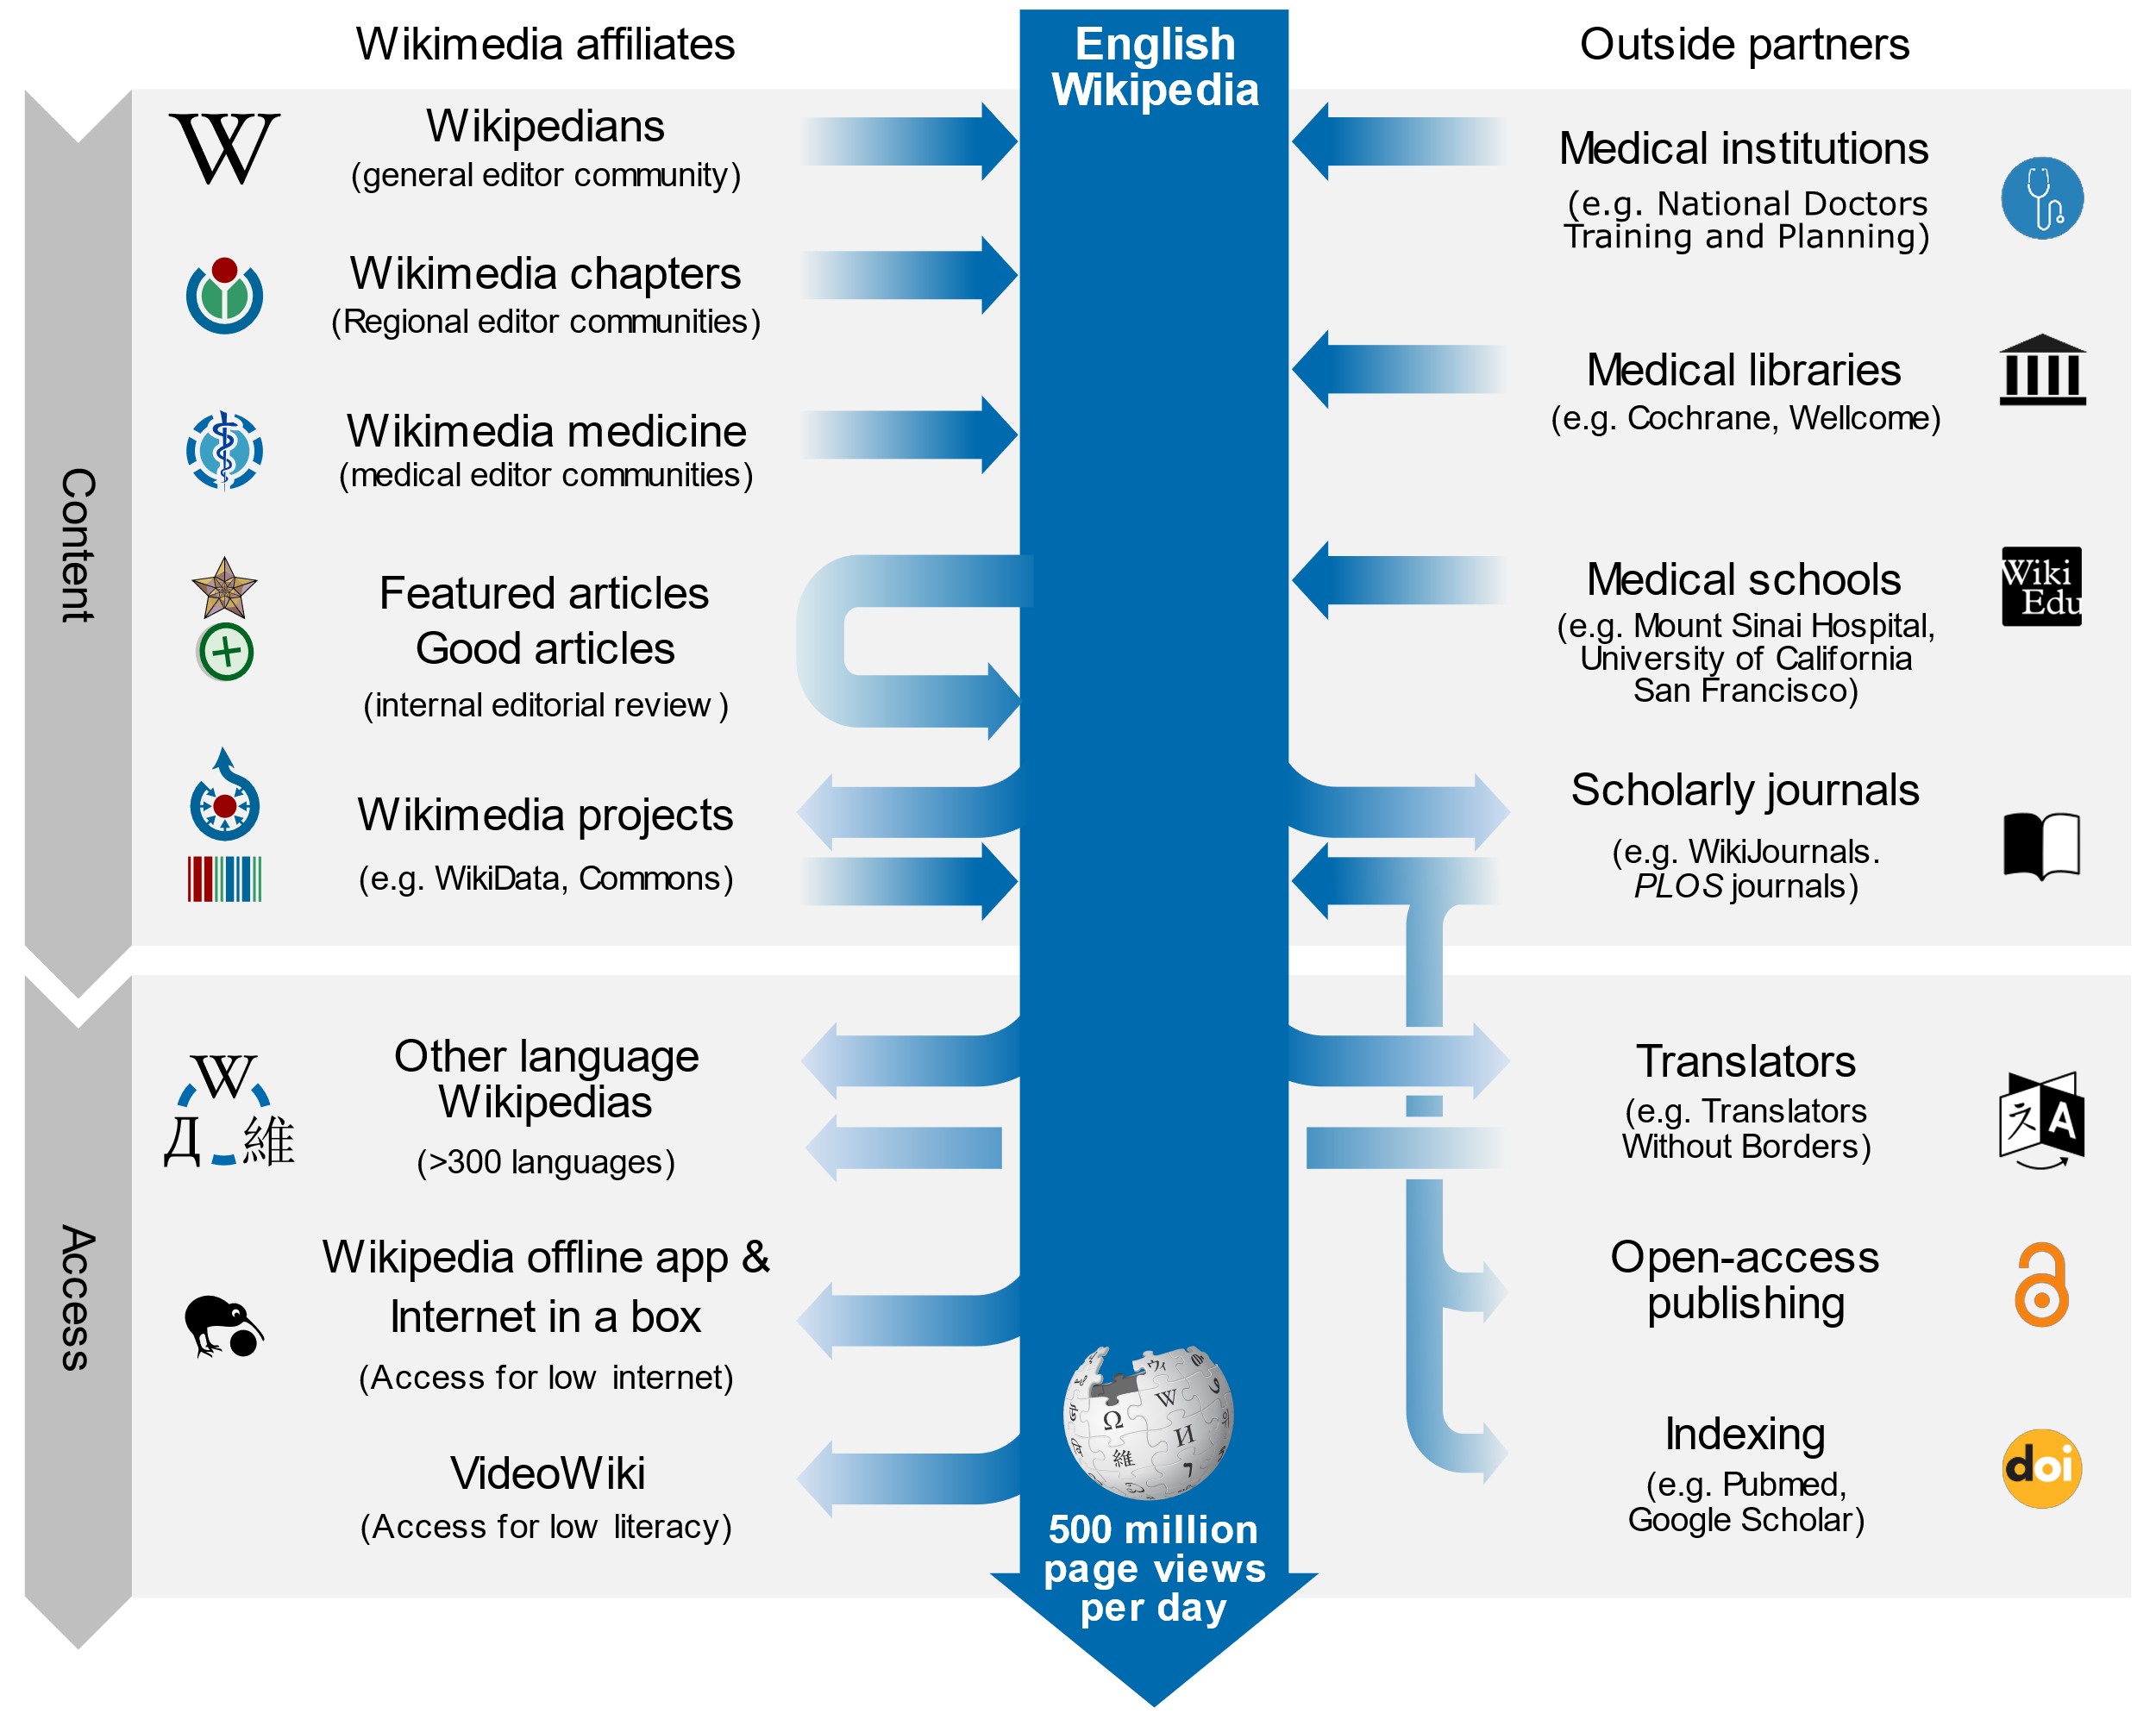
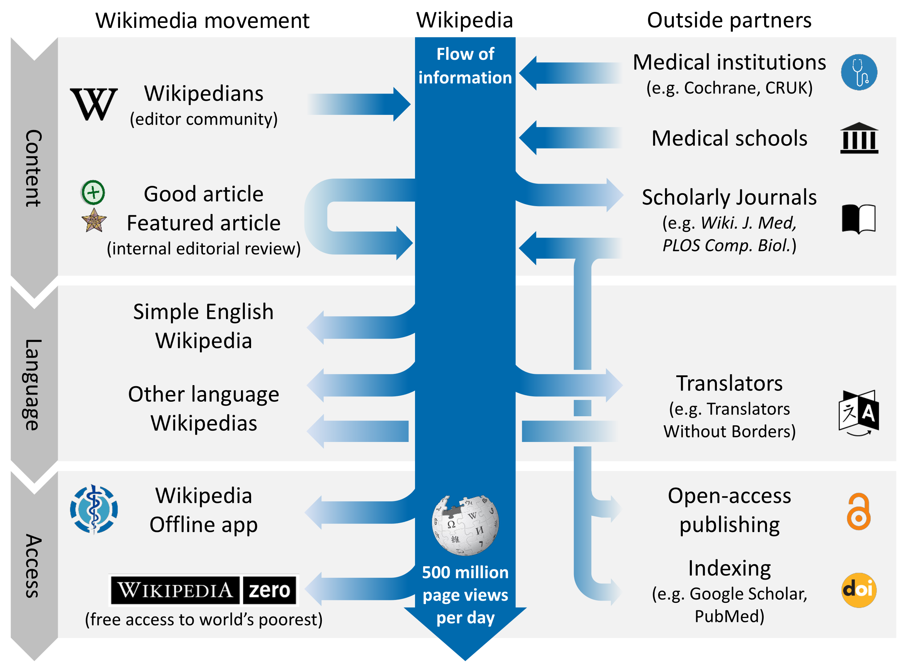
Interactions with the knowledge ecosystem

Slide 36
Implementation models
Practical and proven methods

Slide 37





Development of concepts
2008 – RNA Biology starts requiring authors to update Wikipedia
2014 – Open Med puts Wikipedia page through peer review
2014 – WikiJMed publishes first issue
2018 – WikiJSci & WikiJHum publishes first issue
2012 – PLOS Comp Biol starts publishing ‘topic page’ review format
2013 – Gene starts Gene Wiki Reviews
2018 – PLOS Genetics also starts publishing ‘topic page’ format

Slide 38




Bridging the academic divide
Compatible with any OA journal
Simplest workflow
Well-suited to topics that are missing/start/stub on Wikipedia
Content published into both Wikipedia and academic corpus
Stable, citable, peer-reviewed journal version
Living version with extreme impact of Wikipedia
Example journals
PLOS Genetics
PLOS CompBiol
PLOS ONE
Wiki.J.Med
Wiki.J.Sci
Wiki.J.Hum
Open Medicine
Gene
RNA Biology
Journal first
Restricted by Wikipedia’s CC-BY-SA license
May be only option for highly-developed pages (full replacement typically more difficult Class B and above)
Wikipedia first
Compatible with closed journal
Two versions can be tailored to different audiences
Increased work for authors and reviewers
Parallel
Shafee, T. (2017). Wikipedia-integrated publishing: a comparison of successful models. Health Inform., 26(2).

Slide 39
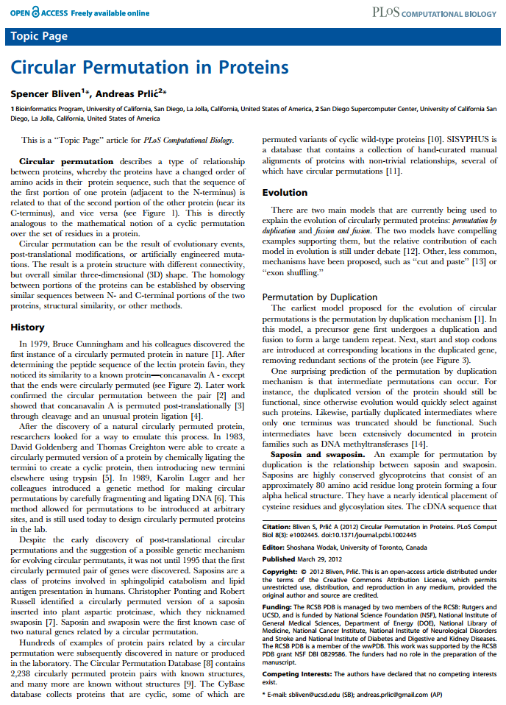
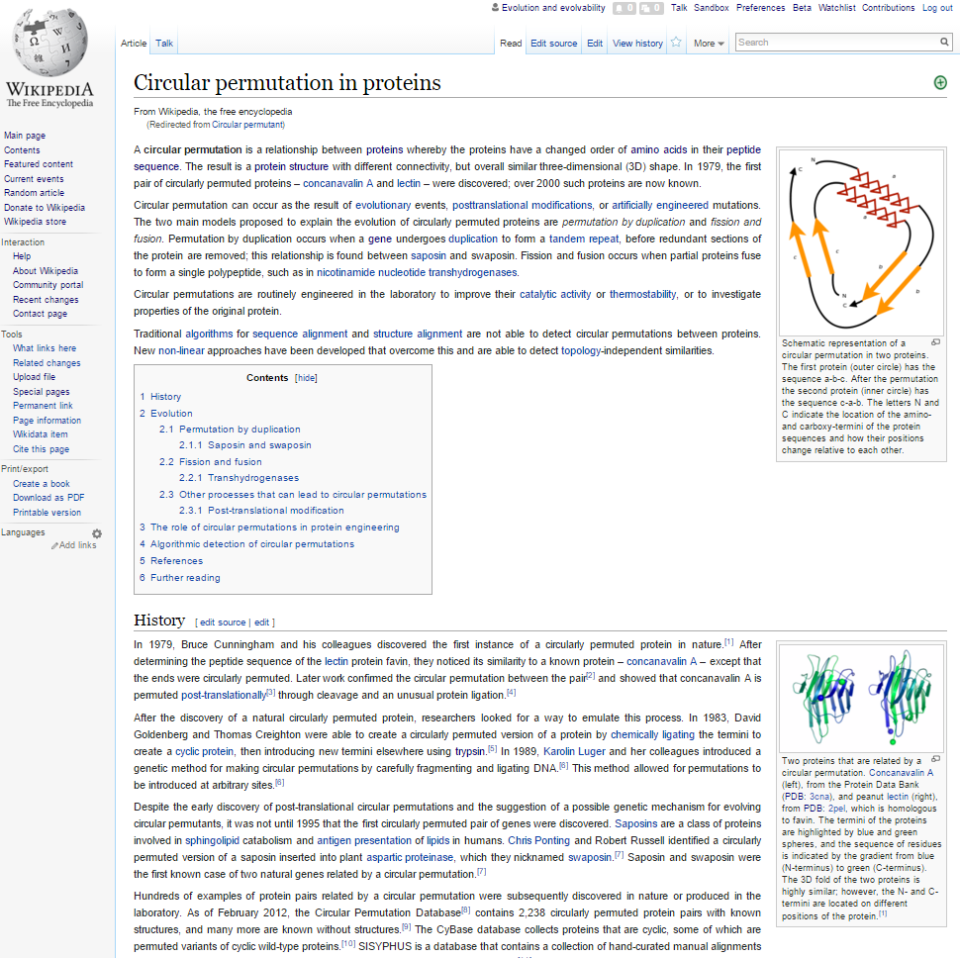
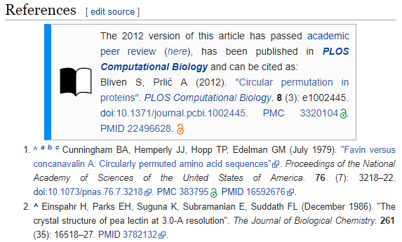
Academic and Wikipedic versions

Slide 40
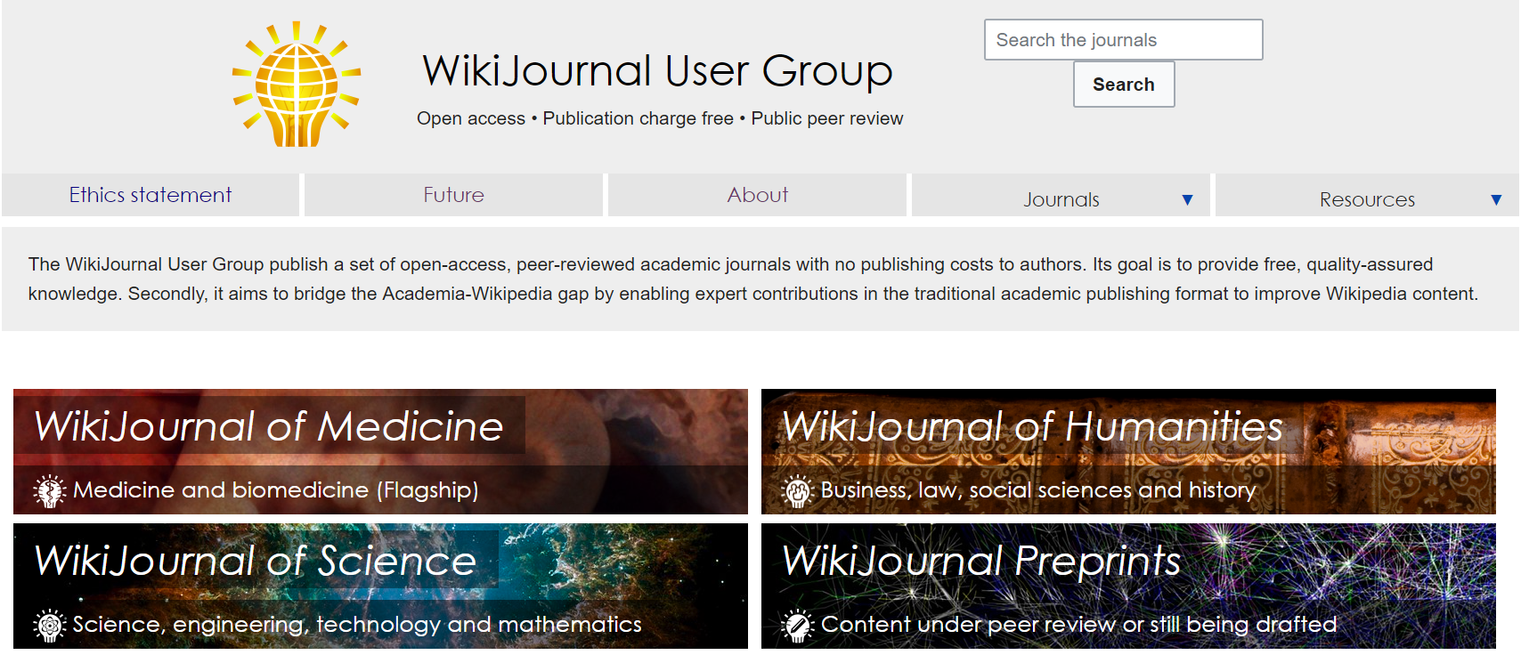
WikiJournals

Slide 41
Example case studies in WikiJournals
Update using Wikipedia page contents as starting point
In all quality ratings cases, individual article sections can typically be rewritten from scratch
Update by re-writing from scratch

Slide 42
Example case studies in WikiJournals
Full review articles
Article sections
Stand-alones
Existing high-quality Wikipedia article updated and submitted
Peripatric speciation
Rosetta stone
Wikipedia article previously existing but flawed/outdated
Lysine
Wikipedia article previously completely absent/stub
Anthracyclines
Wikipedia article section that warranted own page
Gene structure
Wikipedia article previously lacked images
Cell disassembly during apoptosis
Case study
Acute gastrointestinal bleeding from a chronic cause: a teaching case report
Teaching method
A card game for Bell's theorem and its loopholes
Systematic review
Mealtime difficulty in older people with dementia
Image gallery
Medical gallery of Blausen Medical
Partner articles
More technical partner
Dioxins and dioxin-like compounds

Slide 43
A WikiJournal’s publishing flow
Publication
PDF
Citable
Stable
Indexed
Version of record
Preprint
server
Public
peer review
HTML
doi
Highly accessed
Broad readership
Editable and updatable
Wikipedia-integration
WikiJSci Editorial Board. (2018). The aims and scope of WikiJournal of Science. WikiJSci 1(1)

Slide 44
A WikiJournal’s publishing flow
Preprint server
Publication
PDF
Citable
Stable
Indexed
Version of record
Public
peer review
HTML
doi
Highly accessed
Broad readership
Editable and updatable
Wikipedia as preprint
Wikipedia-integration
WikiJSci Editorial Board. (2018). The aims and scope of WikiJournal of Science. WikiJSci 1(1)

Slide 45
A WikiJournal’s publishing flow
Preprint server
Publication
PDF
Citable
Stable
Indexed
Version of record
Public
peer review
HTML
doi
Highly accessed
Broad readership
Editable and updatable
Versioning
Wikipedia as preprint
Wikipedia-integration
WikiJSci Editorial Board. (2018). The aims and scope of WikiJournal of Science. WikiJSci 1(1)

Slide 46
Sooooo… who pays?
Reader subscription / author (e.g. Gene, RNA Biol)
Typically charge subscription fees
Article processing fee of $3300 and $2000 respectively
Journal fee waiver (e.g. PLOS)
For Topic Page review articles, PLOS waives its usual $2250 processing fee
Charitable foundation (e.g. Wiki.J.Med.)
Web hosting cost is covered by the Wikimedia Foundation
Editors donate volunteer labour so no fees of any kind

Slide 47
What does the future hold?
Maximising potential value

Slide 48
Wikimedia journal hosting platform
Wikipedia Sister project
In whole
WikiJournals
PLOS Genetics
Host
Format
Example
One-off
examples in negotiation
In part
Features
Free interface for formatting articles ready for Wikipedia
Expert editors who give free advice and assistance
Specialist tools for facilitating the process

Slide 49
Wikimedia journal hosting platform
Site identity and branding
journals.wikimedia.org / wikijournals.org / journals.wiki / j.wiki
Specialised sidebar items and logos
CC BY default license
Automation of repetitive tasks
Assigning DOIs
Copying accepted articles into latest volume & issue
Formatting PDFs
Specialised extensions
Annotating history to mark version as published
Automated email reminders to reviewers
Wikidata integration to track peer reviews submitted to talkpages
Features

Slide 50

Contact
Email Thomas.Shafee@gmail.com
Google Scholar Thomas Shafee
ResearchGate Thomas Shafee
LinkedIn Thomas Shafee
Journals
WikiJournal of Medicine (WikiJMed.org)
WikiJournal of Science (WikiJSci.org)
PLOS (TopicPagesWiki.plos.org)
Wikipedia
My userpage Search “User:tshafee”
WikiProject Medicine Search “WP:MED”
This presentation
bit.ly/WikiJournal2020b
Shafee, T; Mietchen, D; Su, A. (2017). “Academics can help shape Wikipedia”. Science. 357 (6351): 557–558.
Shafee, T; Masukume, G; Kipersztok, L; Das, D; Häggström, M; Heilman, J. (2017). “The evolution of Wikipedia’s medical content: past, present and future”. JECH. 71(10).
Shafee, T (2017) “Wikipedia-integrated publishing: A comparison of successful models”. Health Inform. 27(2)
WikiJSci Editorial Board (2018). “The aims and scope of WikiJournal of Science”. WikiJournal of Science 1(1):1

